Slide 1
Mohammad almil hisnullah
E41241944 GOL E

Slide 2
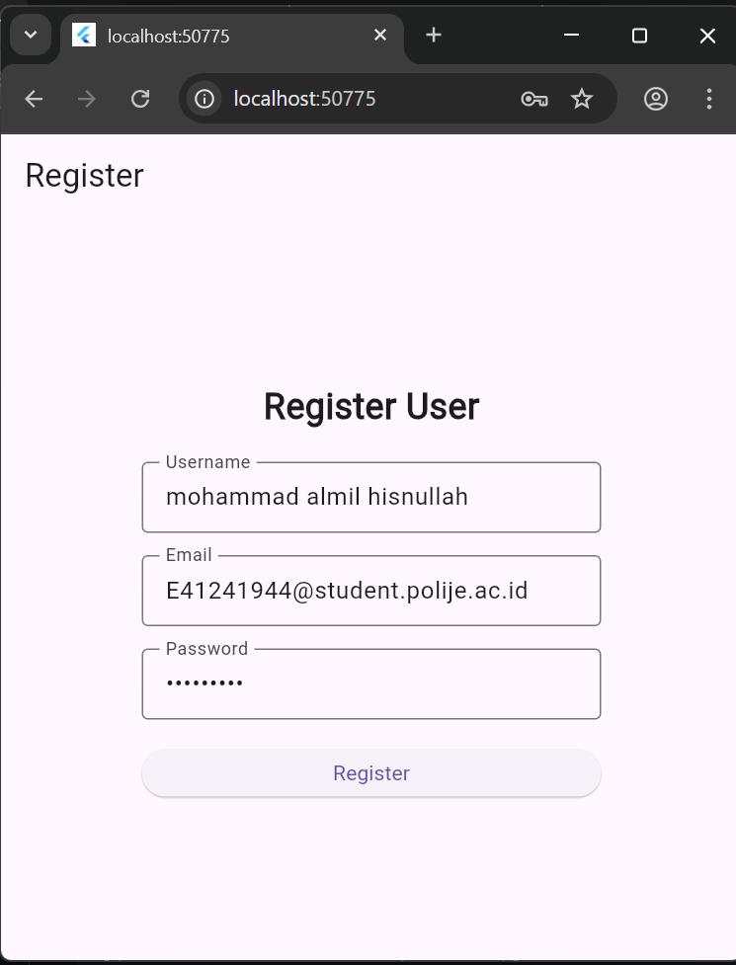
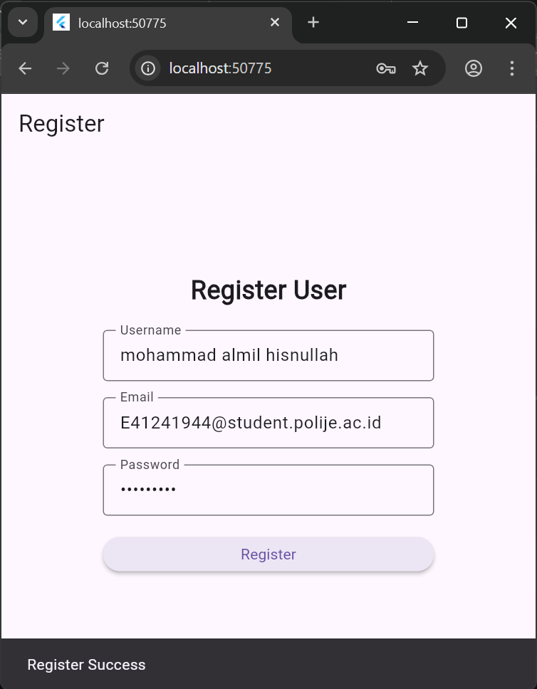

Slide 3



